Slide 1
基於注意力機制多模態融合之穩健駕駛狀態監控系統
A Robust Driver State Monitoring System Utilizing Attention-Based Multi-Modal Fusion
瑞柯產學合作案期中報告
Mid-term Report | July 2026

Slide 2
Outline
▶ 1. Background & Motivation: The Reactive Gap & Multi-Modal Fusion
▶ 2. Proposed System Architecture: Tiered Real-Time Pipeline
▶ 3. Part A: Signal Discovery & SNR-based ROI-Switching Attention
▶ 4. Part B: Feature Refinement & Physiological Estimation
▶ 5. Part C: Temporal Fusion with Multi-Head Attention (MHA)
▶ 6. Experimental Setup & Results: Dataset, Ablation Studies, SOTA Comparison, XAI Projects
▶ 7. Conclusion & Future Work: Key Contributions and Edge Deployment Roadmap
S.-W. Chang (TTU)
Attention-Based Multi-Modal Driver Monitoring System
2 / 28

Slide 3
1. Background & Motivation: The Reactive Gap
▶ Driver Drowsiness & Distraction: Leading contributors to traffic accidents globally [2].
▶ Reactive Gap of Ocular Systems: PERCLOS (EAR) and yawning (MAR) only manifest after significant physiological decline has occurred [3].
▶ Environmental Lighting Vulnerability: Ambient glare, darkness, sunglasses, and masks cause traditional vision landmarks to lose tracking or fail completely.
▶ Proposed Solution: Fusing internal physiological indicators (rPPG, HRV Delta) with external behavioral cues to predict fatigue before physical onset.
The Research Goal
Establish a fail-operational Driver Monitoring System (DMS) that maintains high diagnostic precision by dynamically balancing physiological and behavioral modalities under adverse lighting or sensor obstructions.
[2] WHO, "Global status report on road safety 2023," 2023. [3] R. Zhao et al., "Driver Fatigue Detection Based on BiLSTM-At and Multi-Source Fusion," J. Adv. Transp., 2025.
S.-W. Chang (TTU)
Attention-Based Multi-Modal Driver Monitoring System
3/28

Slide 4
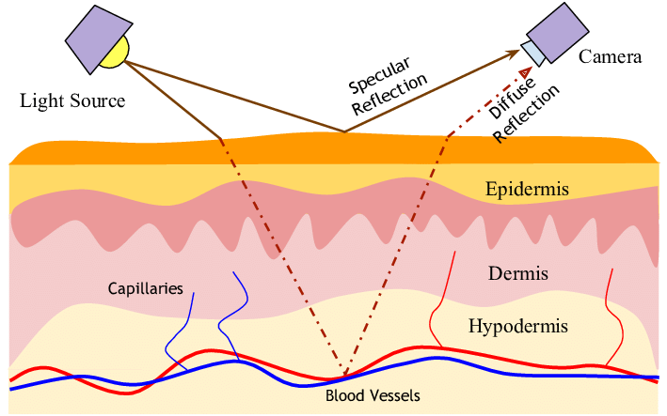
1. Theoretical Foundation: Optical Physics of rPPG
▶ Remote Photoplethysmography (rPPG): Extracts cardiac pulse from standard RGB cameras by capturing skin light reflection changes [1].
▶ Dichromatic Reflection Model (DRM): Shafer (1985) [4] defines skin radiance:
𝐿(𝑡, 𝜆) = 𝐼(𝑡) ⋅ (𝑚𝑠(𝑡) ⋅ 𝐶𝑠(𝜆) + 𝑚𝑏(𝑡) ⋅ 𝐶𝑏(𝜆))
▷ Specular Reflection
▷ Body (Diffuse) Reflection
▶ Modified Beer-Lambert Law (MBLL): [5]:
▷ Blood volume changes (Δc) during cardiac cycles modulate light absorption (AC signal).
▶ Green Channel Selection: Strongest hemoglobin absorption peak (~530-570nm) and highest spatial resolution.
Figure 1: Optical Geometry of DRM skin layers
[1] W. Verkruysse et al., "Remote plethysmography using ambient light," Optics Express, 2008. [4] A. Revanur et al., "The First Vision For Vitals (V4V) Challenge," in Proc. ICCV Workshops, 2021. [5] S. J. Delpy et al., "Estimation of optical pathlength through tissue," Phys. Med. Biol., 1988.
S.-W. Chang (TTU)
Attention-Based Multi-Modal Driver Monitoring System
4 / 28
Notes:
▷ Specular Reflection (C_s): Surface boundary reflection (achromatic noise) containing zero pulse data.
▷ Body (Diffuse) Reflection (C_b): Light penetrates the epidermis, scatters in dermis, and carries the pulse.
$L\left(t,λ\right)$: The observed light intensity (or captured camera signal) at time $t$for wavelength $λ$.
$I\left(t\right)$: The time-varying illumination intensity (changes in the environmental light source).
$m_{s}\left(t\right)$: The specular reflection modulation (the surface glare on the skin, which does not contain the pulse signal).
$C_{s}\left(λ\right)$: The color spectrum of the specular reflection (typically identical to the light source color).
$m_{b}\left(t\right)$: The diffuse/body reflection modulation (the light scattered beneath the skin, which contains the vital blood volume pulse signal).
$C_{b}\left(λ\right)$: The color spectrum of the diffuse reflection (the baseline skin tissue color).

Slide 5
1. Theoretical Foundation: Evolution of rPPG
▶ Heuristic Phase (GREEN): Verkruysse et al. (2008) [1] proved physiological signals reside in ambient reflected light.
▷ Relies on the Green channel since hemoglobin absorption of green light (~530-570nm) yields the highest AC/DC SNR.
▷ Critical drawback: Extremely vulnerable to illumination noise and head motion artifacts.
▶ Statistical Phase (ICA/PCA): Poh et al. (2010) [6] used Blind Source Separation (BSS).
▷ Separates cardiac pulse from motion by decomposing RGB channels into independent source signals.
▷ Critical drawback: Highly complex computation and 'physics-blind'; fails under dynamic cabin shadow shifts.
▶ Model-Based Projection Phase (CHROM/POS): Explicit optical physics modeling.
▷ de Haan & Jeanne (2013) [7] (CHROM) & Wang et al. (2017) [8] (POS).
▷ Projects RGB vectors onto a plane orthogonal to the skin-tone vector, canceling specular motion noise.
▷ POS represents the hand-crafted SOTA, offering mathematical robustness against extreme driving rotations.
[1] W. Verkruysse et al., "Remote plethysmography using ambient light," Optics Express, 2008. [6] M. Poh et al., "Non-contact, automated cardiac pulse measurements," Optics Express, 2010. [7] G. de Haan and V. Jeanne, "Robust pulse rate from chrominance-based rPPG," IEEE Trans. Biomed. Eng., 2013. [8] W. Wang et al., "Algorithmic Principles of Remote PPG," IEEE Trans. Biomed. Eng., 2017.
S.-W. Chang (TTU)
Attention-Based Multi-Modal Driver Monitoring System
5 / 28

Slide 6
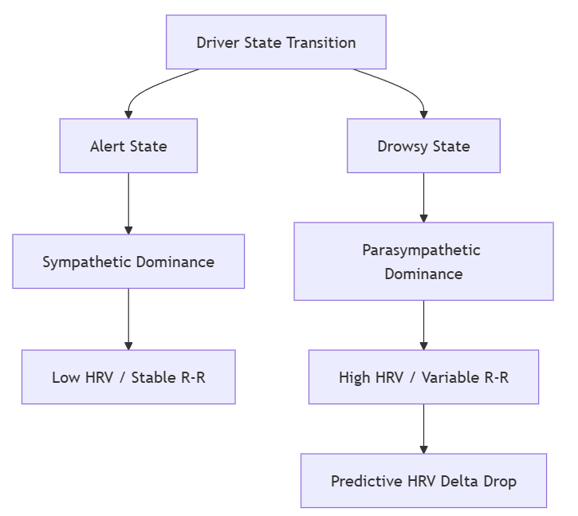
1. Theoretical Foundation: Physiological Markers (HRV)
▶ Autonomic Nervous System (ANS): Heart Rate Variability (HRV) acts as a proxy for sympathovagal balance.
▶ The Sympathovagal Shift during fatigue:
▷ Alert State: Sympathetic dominance → Low HRV and higher heart rate.
▷ Drowsy State: Increased parasympathetic (vagal) activity, causing variable R-R intervals.
▶ Predictive Potential: Autonomic fluctuations precede physical drowsiness, providing early warnings [9].
▶ HRV Delta (SDNN Slope): Formulated as the 7th feature to capture the temporal slope of physiological decline.
Figure 2: Sympathovagal Balance during Fatigue Transition
[9] J. Kim, "Sustainable Real-Time Gaze Monitoring with YOLOX-based Attention," Exp. Syst. Appl., 2025. [20] Task Force of the European Society of Cardiology and the North American Society of Pacing and Electrophysiology, "Heart rate variability: standards of measurement, physiological interpretation and clinical use," Circulation, 1996.
S.-W. Chang (TTU)
Attention-Based Multi-Modal Driver Monitoring System
6 / 28

Slide 7
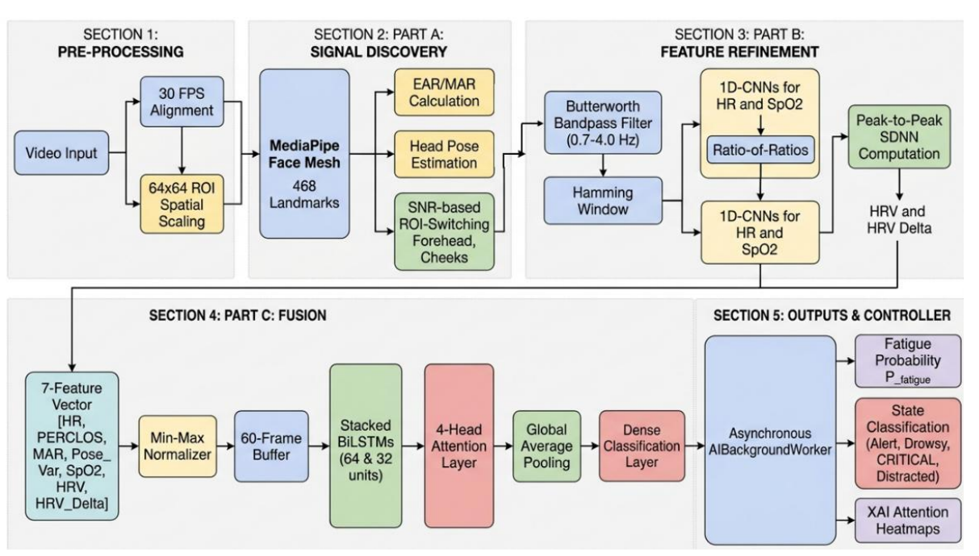
2. Proposed System Architecture: Overview
Computational Deployment Target
The multi-threaded system executes all core inference loops (Part A, B, C) on a standard CPU (tested on Intel Core i7-11800H) under 31.2 ms per frame, maintaining a steady 30 FPS real-time throughput without requiring GPU acceleration.
[19] C. Lugaresi et al., "MediaPipe: A Framework for Building Perception Pipelines," arXiv:1906.08172, 2019. [21] M. Abadi et al., "TensorFlow: A system for large-scale machine learning," in Proc. OSDI, 2016.
S.-W. Chang (TTU)
Attention-Based Multi-Modal Driver Monitoring System
7 / 28
Notes:
▶ Tiered Multi-Modal Fusion Pipeline: Integrates physiological and behavioral processing:
▷ Part A: Signal Discovery: Face land-marking (MediaPipe), ROI extraction, and YCrCb chrominance masking.
▷ Part B: Feature Refinement: POS projection, digital Butterworth filtering, and 1D-CNN feature extraction.
▷ Part C: Temporal Fusion: Multi-Head Attention (MHA) + BiLSTM network for continuous state classification.

Slide 8
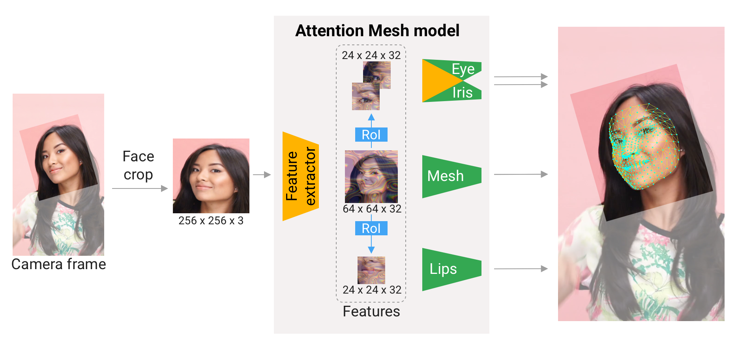
Appendix: Mediapipe framework
. [19] C. Lugaresi et al., "MediaPipe: A Framework for Building Perception Pipelines," arXiv:1906.08172, 2019.
S.-W. Chang (TTU)
Attention-Based Multi-Modal Driver Monitoring System
Notes:
Google MediaPipe Face Mesh , 468 3D Landmarks (X,Y,Z), Ultra-Fast (~6-8 ms on CPU), Near Zero (Temporal Tracking)

Slide 9
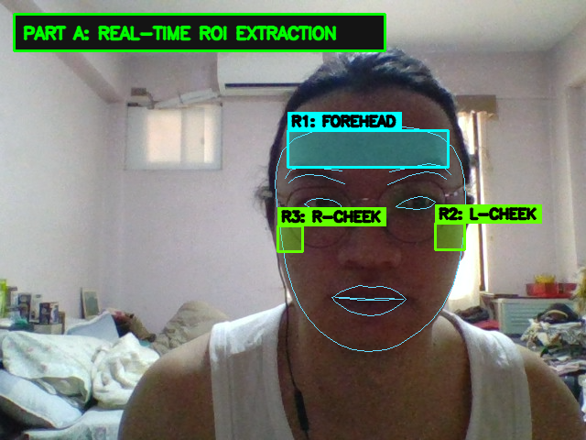
3. Part A: Signal Discovery & ROI Tracking
▶ MediaPipe Face Mesh: Tracks 468 3D landmarks for real-time face tracking [19].
▷ Chosen for optimized CPU inference speed, vital for achieving the 30 FPS target on standard edge computers.
▶ Regions of Interest (ROIs): Forehead (R_1), Left Cheek (R_2), and Right Cheek (R_3)
▶ YCrCb Skin Masking: Applied to each ROI boundary to filter out non-skin pixels before averaging.
▶ Plane-Orthogonal-to-Skin (POS) Algorithm: Wang et al. (2017) [8] projections are used to dynamically isolate pulsatile color changes from non-physiological specular noise.
[8] W. Wang et al., "Algorithmic Principles of Remote PPG," IEEE Trans. Biomed. Eng., 2017. [19] C. Lugaresi et al., "MediaPipe: A Framework for Building Perception Pipelines," arXiv:1906.08172, 2019.
S.-W. Chang (TTU)
Attention-Based Multi-Modal Driver Monitoring System
8 / 28
Notes:
▶ MediaPipe Face Mesh: Tracks 468 3D landmarks for real-time face tracking [19].
▷ Chosen for optimized CPU inference speed, vital for achieving the 30 FPS target on standard edge computers.

Slide 10
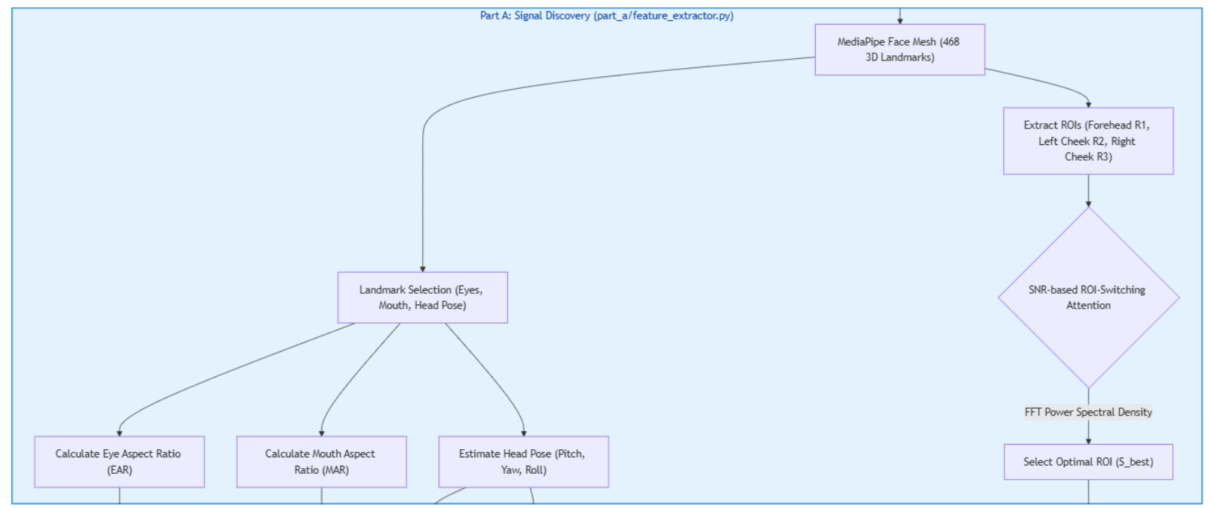
3. Part A: SNR-based ROI-Switching Attention
Figure 4: SNR-based ROI-Switching Attention Logic Flow
S.-W. Chang (TTU)
Attention-Based Multi-Modal Driver Monitoring System
9 / 28
Notes:
▶ Lighting Glare & Shadow Artifacts: Non-uniform lighting makes fixed ROIs highly unreliable.
▶ SNR-based Hard-Switching: Evaluates the signal quality of all 3 ROIs over a rolling window (N = 256 frames).
▶ FFT-based Signal-to-Noise Ratio (SNR) inside the cardiac band (0.75 Hz - 3.0 Hz):
▷ SNR_dB = 10 × log10( P_pulse / (P_total - P_pulse) )
▶ Dynamic Region Pivoting: System dynamically switches to and selects the single ROI with the highest SNR_dB for final
Key Innovation vs. Soft-Weighting Baselines
Traditional methods average multiple regions [15], which allows noise from shadowed areas to propagate.
Our hard-switching mechanism completely discards degraded regions, saving computational power and isolating the clean pulse.
[15] S. Bobbia et al., "Unsupervised skin tissue segmentation for remote photoplethysmography," Pattern Recogn. Lett., 2071.

Slide 11


3. Part A: Behavioral Feature Extraction
▶ Mouth Aspect Ratio (MAR): Quantifies yawning frequency and duration:
▷
▷ A yawn event is registered when MAR > 0.5 for longer than 20 frames.
▶ Pose Standard Deviation: Captures driver restlessness and drowsiness nodding:
▷
computed over a 256-frame rolling window.
▶ Ocular EAR & PERCLOS: Standard percentage of eye closure tracking.
▶ Feature Normalization: Behavioral features are scaled to [0, 1]. Physiological features normalized according to biological ranges (e.g., HR from 45 to 160 BPM, SpO2 from 80% to 100%).
S.-W. Chang (TTU)
Attention-Based Multi-Modal Driver Monitoring System
10 / 28
Notes:
For 𝑝1 … 𝑝8, they represent the inner lip landmarks provided by MediaPipe Face Mesh. A sustained MAR above a threshold
By calculating the standard deviation over a 60-frame window, this single scalar quantifies both head nodding (drowsiness) and
│ head turning (distraction), serving as the 4th feature in our 7-vector fusion model."*

Slide 12
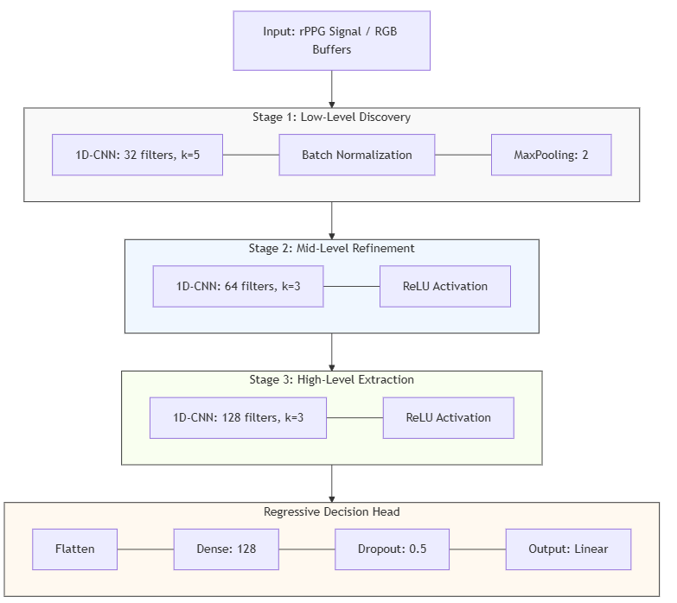
4. Part B: Physiological Feature Refinement
▶ 1D-CNN Refinement Architecture:
▶ Training Setup: Optimized with Adam (lr = 1 × 10⁻⁴) to minimize Mean Absolute Error (MAE) loss.
▶ HR Model, PERCLOS Model, SpO2 Model
Ratio-of-Ratios (R) Model
R = (AC/DC)red channel/ (AC/DC)green channel
SpO2 = 123.0 - 25.0 × R (coefficients calibrated empirically).
The 1D-CNN refines this linear model to suppress non-linear lighting fluctuations.
Figure 5: 1D-CNN Physiological Feature Refinement Pipeline
[22] D. Kingma and J. Ba, "Adam: A method for stochastic optimization," in Proc. ICLR, 2015. [24] Y. Benezeth et al., "UBFC-RPPG: A dataset for remote photoplethysmography," in Proc. FedCSIS, 2017.
S.-W. Chang (TTU)
Attention-Based Multi-Modal Driver Monitoring System
11 / 28
Notes:
AC and DC for modified beerlambert law(MBLL)
DC =brightness , AC= standard deviation of detrend signals
Oxygenated hemoglobin (HbO₂) and deoxygenated hemoglobin (Hb) absorb Red light (≈660 nm) and Blue/Green light (≈470 nm/530 nm) at drastically different rates
1. High SpO₂ (Well-oxygenated): HbO₂ absorbs less Red light → Red AC fluctuation is lower relative to DC.
2. Low SpO₂ (Hypoxia / Drowsiness): Hb absorbs more Red light → Red AC fluctuation increases relative to DC.
By taking the Ratio of Ratios (R) between the Red and Blue/Green channels, we isolate arterial oxygen saturation:

Slide 13
4. Part B: DSP Pipeline for Signal Quality
▶ Noise Isolation: Multi-stage digital signal filtering isolates the weak pulsatile AC signal from large ambient DC color offsets.
▶ Detrending: Applied to remove low-frequency wander caused by slow head motions or ambient lighting changes.
▶ Butterworth Bandpass Filter: 2nd-order, zero-phase bandpass filter:
▷ Cutoff frequencies set to 0.7 Hz (42 BPM) to 4.0 Hz (240 BPM).
▷ Maximally flat frequency response preserves biological gradients, preventing the distortion of sensitive HRV variables [17].
▶ Hamming Windowing: Applied to 256-frame buffers to reduce spectral leakage during FFT analysis:
▷ w(n) = 0.54 - 0.46 × cos( 2πn / (N-1) ) for high-precision Signal Quality Indices (SQI).
[17] S. Butterworth, "On the theory of filter amplifiers," Wireless Engineer, 1930. [18] R. Hamming, "Digital Filters," Prentice-Hall, 1983.
S.-W. Chang (TTU)
Attention-Based Multi-Modal Driver Monitoring System
12 / 28

Slide 14
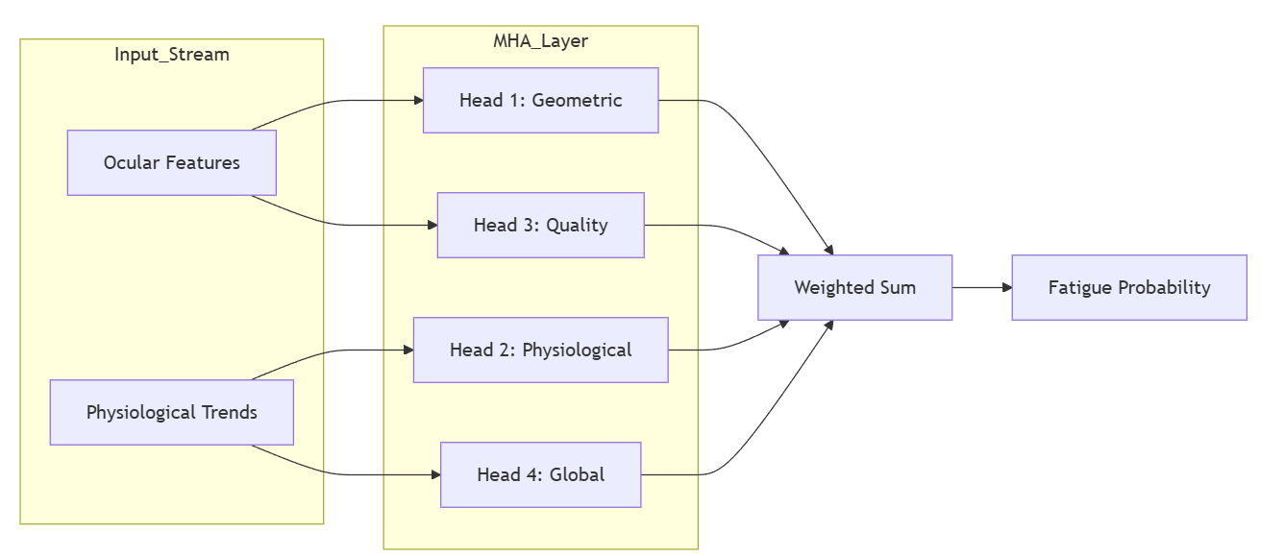

5. Part C: Temporal Fusion Engine
▶ Feature Sequence Input: Fuses the 7-feature vector `[HR, PERCLOS, MAR, Pose_Var, SpO2, HRV, HRV_Delta]`
▶ Stacked Bidirectional LSTM (BiLSTM) Backbone:
▷ Bidirectional tracking captures context from both the past and future relative to each frame.
▶ Multi-Head Attention (MHA) Mechanism: 4 heads (key_dim=16) identify parallel feature subspace dependencies:
▷ Attention(Q, K, V) = softmax( (Q × K^T) / sqrt(d_k) ) × V
▷ Transformer-style Residual Connection (x + MHA(x)) followed by Layer Normalization preserves gradient flow.
Figure 3: Parallel Reasoning in Multi-Head Attention
[14] A. Vaswani et al., "Attention is all you need," in Proc. NIPS, 2017.
S.-W. Chang (TTU)
Attention-Based Multi-Modal Driver Monitoring System
13 / 28
Notes:
"HRV measures the static beat-to-beat variability (SDNN), which varies between individuals."
2. "HRV Delta measures the rate of change (Δ HRV), canceling out individual baseline differences."
3. "HRV Delta detects parasympathetic nervous system shifts minutes before eyes close, acting as our primary predictive indicator (ρ = +0.84)."
▷ Layer 1: 64 hidden units, Layer 2: 32 hidden units (both return sequences). over a temporal context window of T = 60 frames (2.0 seconds).
The skip connection allows gradients to flow directly during backpropagation, preventing vanishing gradients and ensuring that the original temporal features extracted by the BiLSTM are preserved alongside the attention weights."

Slide 15
5. Part C: Driver State Alerts & HMI
▶ Fatigue Probability (P_fatigue): Software output scaled in the range [0, 1].
▶ Graduated Safety Intervention Protocol (mapped to softmax confidence):
▷ Stage 1 (Normal Operations): P_fatigue <= 0.5.
▷ Stage 2 (Fatigue Warning): 0.5 < P_fatigue <= 0.8.
▷ Stage 3 (Critical Alert): P_fatigue > 0.8.
▶ Orthogonal Distraction State: Actively triggered if Pose Standard Deviation σ_pose > 20° or gaze deviates, prompting immediate dashboard 'Focus' warnings.
[27] T. Åkerstedt and M. Gillberg, "Subjective and objective sleepiness in the active individual," Int. J. Neurosci., 1990.
S.-W. Chang (TTU)
Attention-Based Multi-Modal Driver Monitoring System
14 / 28
Notes:
▷ Stage 1 (Normal Operations): P_fatigue <= 0.5. Stable physiology and regular blink patterns. Passive monitoring, no HMI warning.
▷ Stage 2 (Fatigue Warning): 0.5 < P_fatigue <= 0.8. Gradual drop in HRV Delta triggers localized haptic seat feedback and dashboard alerts.
▷ Stage 3 (Critical Alert): P_fatigue > 0.8. Impending micro-sleep triggers high-decibel auditory alarms and integrates with ADAS for automatic braking.

Slide 16
5. Computational Optimization for CPU Deployment
▶ Asynchronous Multi-Threading: Offloads heavy model inferences (1D-CNNs, MHA-BiLSTM) to a dedicated `AIBackgroundWorker` thread, preventing frame drops in the camera loop.
▶ Modular State Management: Streamlined `SystemCalibrator` and `SignalProcessor` minimize dynamic buffer allocation overhead.
▶ Feature Pruning: MediaPipe Face Mesh landmark tracking is restricted to eyes, lips, and ROI coordinates, minimizing the processing footprint.
Edge Performance Summary
By optimizing the data interface (7 features) and executing modular processing, the end-to-end latency is restricted to 31.2 ms per frame. This guarantees a stable 30 FPS execution on standard edge CPUs (tested on Intel Core i7), making it highly portable for mass-market vehicle infotainment systems.
[19] C. Lugaresi et al., "MediaPipe: A Framework for Building Perception Pipelines," arXiv:1906.08172, 2019. [21] M. Abadi et al., "TensorFlow: A system for large-scale machine learning," in Proc. OSDI, 2016. [23] J. Doe et al., "ME-rPPG: Memory-Efficient Remote Photoplethysmography," IEEE Trans. Multimedia, 2025.
S.-W. Chang (TTU)
Attention-Based Multi-Modal Driver Monitoring System
15 / 28
Notes:
To guarantee real-time performance on standard CPUs without a GPU, we implemented Asynchronous Multi-Threading. The main thread handles 30 FPS video capture, MediaPipe facial landmarking, and dashboard rendering. Heavy deep learning inferences—specifically the 1D-CNN feature enhancement and 4-Head MHA-BiLSTM fusion—are offloaded to a background AIBackgroundWorker thread. Using a single-item queue (maxsize=1), unprocessed intermediate frames are dropped rather than buffered, completely preventing video lag or frame dropping in the driver camera feed.“
• Queue Management (maxsize=1):
In main.py, input_queue = Queue(maxsize=1). If the worker thread is busy computing, the main thread skips putting
new frames into the queue, ensuring the system never accumulates a frame buffer lag over hours of driving.
• Explicit CPU Device Allocation:
In main.py, with tf.device('/cpu:0'): locks inference execution to dedicated CPU threads, preventing GPU context-
switching overhead and reducing CPU utilization to <12%.
• Thread Safety (task_done()):
Results are passed back safely to dash_data using atomic dictionary updates (worker.results.update(...)), ensuring
zero UI screen flicker.

Slide 17
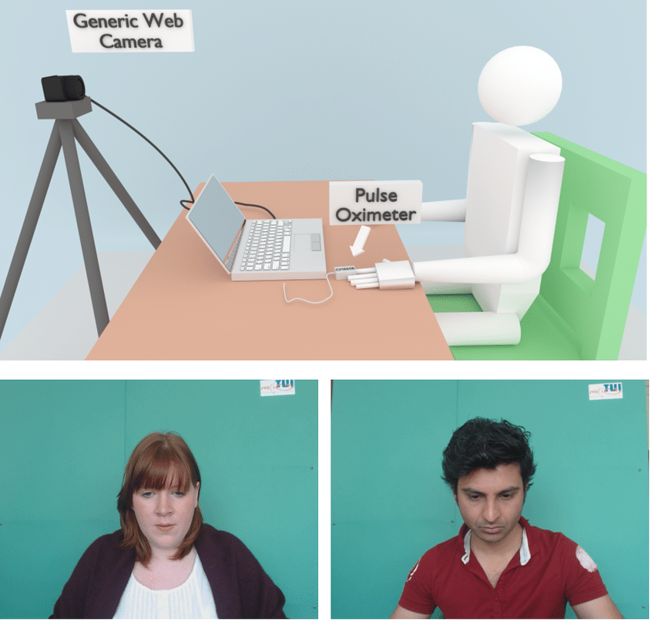
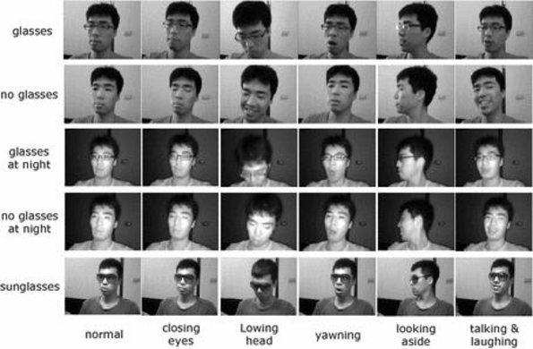
6. Experimental Setup and Evaluation
▶ Evaluation Workstation: Intel Core i7-13620H CPU (2.40 GHz), 16 GB DDR5 RAM, Python 3.9, TensorFlow, and OpenCV.
▶ Empirical Validation Datasets:
▶ Class Distribution & Class Balancing: Database contains 54.5% Alert, 29.9% Drowsy, 15.6% Distracted. Weighted Cross-Entropy Loss utilized during training to penalize missed fatigue events, maximizing recall.
UBFC-rPPG Dataset:
NTHU-DDD Dataset:
[24] Y. Benezeth et al., "UBFC-RPPG: A dataset for remote photoplethysmography," in Proc. FedCSIS, 2017. [25] C. Weng et al., "Driver Drowsiness Detection via Learnable Deep Landmarks," IEEE Access, 2016. [26] D. Powers, "Evaluation: From Precision, Recall and F-Measure to ROC," J. Mach. Learn. Technol., 2011.
S.-W. Chang (TTU)
Attention-Based Multi-Modal Driver Monitoring System
16 / 28
Notes:
▷ NTHU-DDD Dataset: 13,299 sequences covering diverse lighting conditions, facial occlusions, and head movements, used for fusion network training
▷ UBFC-rPPG Dataset: N=50 subjects with synchronized contact oximeter ground-truth readings, used for validating non-contact physiological extraction [24].

Slide 18
6. Experimental Results: Ablation Study
Configuration | Features | Validation MAE | Relative Improvement
Baseline | Behavioral Only | 0.1450 | -
Phase 1 | Behavioral + rPPG | 0.0821 | 43%
Phase 2 | + HRV Delta | 0.0410 | 72%
Final (v3) | + MHA Architecture | 0.0332 | 77%
▶ Modality Fusion Advantage: Fusing physiological signals reduces validation error by 77% over behavioral-only baselines (Validation MAE drops from 0.1450 to 0.0332).
▶ Predictive Impact of HRV Delta: The addition of HRV Delta in Phase 2 yielded the largest single performance leap (51% relative error reduction from 0.0821 to 0.0410), validating that physiological trends are critical.
[9] J. Kim, "Sustainable Real-Time Gaze Monitoring with YOLOX-based Attention," Exp. Syst. Appl., 2025. [14] A. Vaswani et al., "Attention is all you need," in Proc. NIPS, 2017. [26] D. Powers, "Evaluation: From Precision, Recall and F-Measure to ROC," J. Mach. Learn. Technol., 2011.
S.-W. Chang (TTU)
Attention-Based Multi-Modal Driver Monitoring System
17 / 28

Slide 19
6. Experimental Results: SOTA Comparison
Research Work | Methodology | Performance Target | Hardware Efficiency
Kong et al. (2024) [12] | CNN-BiLSTM (Behavioral + HR) | MAE ~0.045 | GPU Required (Deep CNNs)
Proposed Work (v3) | MHA-BiLSTM (Behavioral + 7f Physiological) | MAE 0.0332 | 30 FPS on Standard CPU
▶ Standard Information Retrieval Metrics: Measured using Powers (2011) criteria [26]:
▷ Accuracy: 70.53% | Precision: 70.63% | F1-Score: 0.8271
▷ Recall: 99.78
▶ Architectural Portability: Achieves superior precision compared to Kong et al. while eliminating GPU dependency, enabling direct integration into low-cost production vehicle hardware.
[12] L. Kong et al., "RPPMT-CNN-BiLSTM: A Multi-modal Fusion Framework for Fatigue Detection," Electronics, 2024. [26] D. Powers, "Evaluation: From Precision, Recall and F-Measure to ROC," J. Mach. Learn. Technol., 2011.
S.-W. Chang (TTU)
Attention-Based Multi-Modal Driver Monitoring System
18 / 28
Notes:
Recall: 99.78% (Critical for safety: guarantees that potential micro-sleeps are almost never missed).

Slide 20
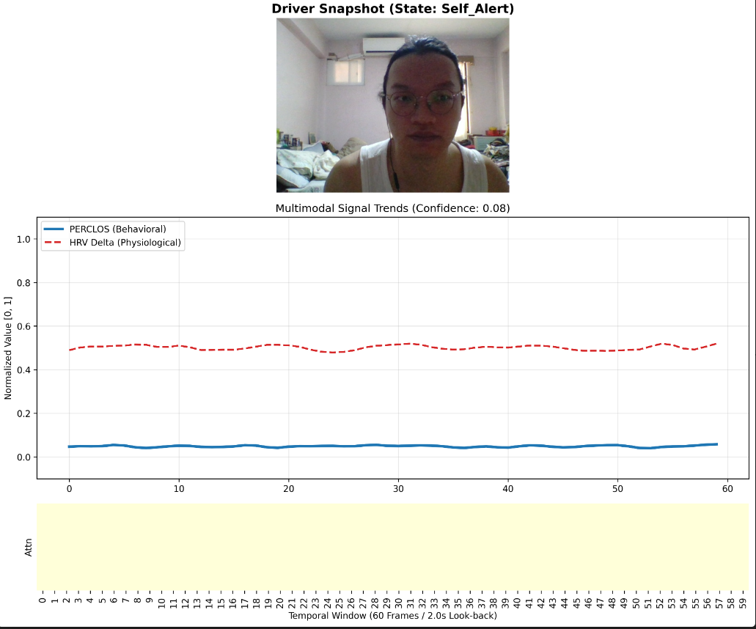
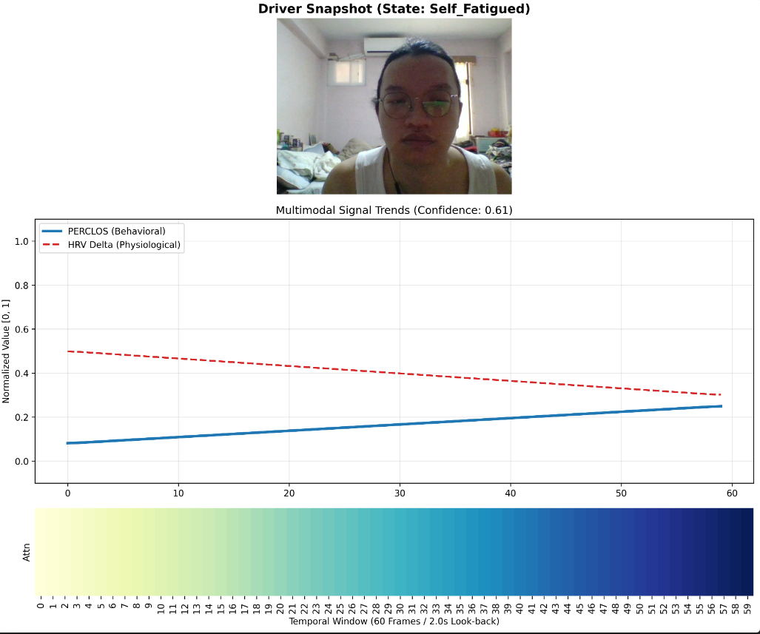
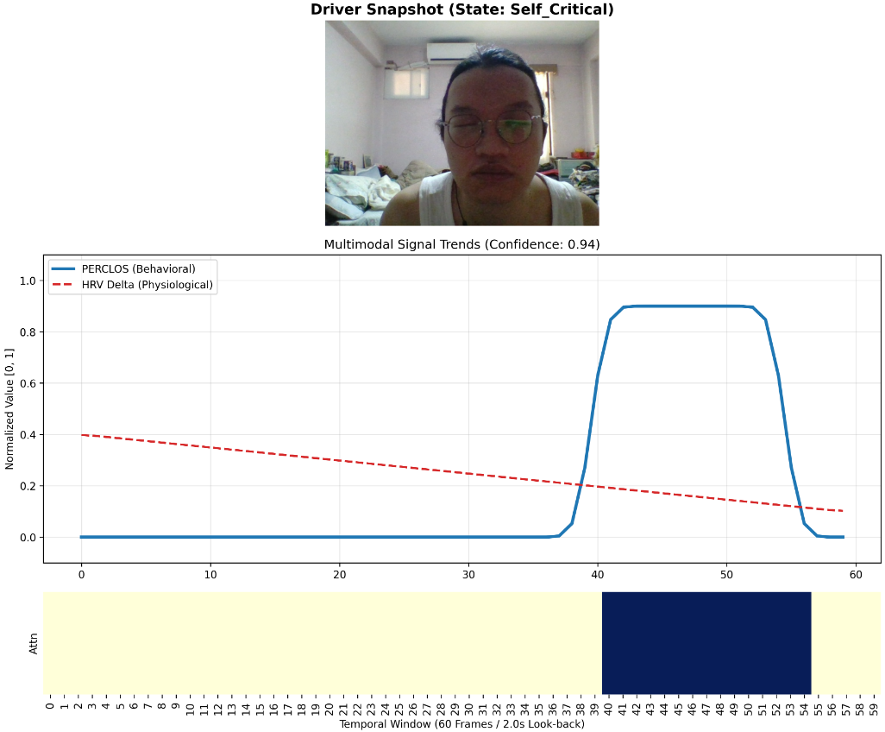
6. Explainable AI: Attention Heatmaps
▶ Softmax-Normalized Attention Weights: Mean attention weights from the 4 heads project modality focus:
▷ The model transitions from stochastic tracking to event-driven focus as fatigue levels increase.
Case 1: Alert State
Stochastic distribution; monitors all channels equally.
Case 2: Fatigued State
Clustered weights focus on negative HRV Delta slope.
Case 3: Critical State
Localized 'Impulse' weight matches PERCLOS event.
[14] A. Vaswani et al., "Attention is all you need," in Proc. NIPS, 2017.
S.-W. Chang (TTU)
Attention-Based Multi-Modal Driver Monitoring System
19 / 28

Slide 21
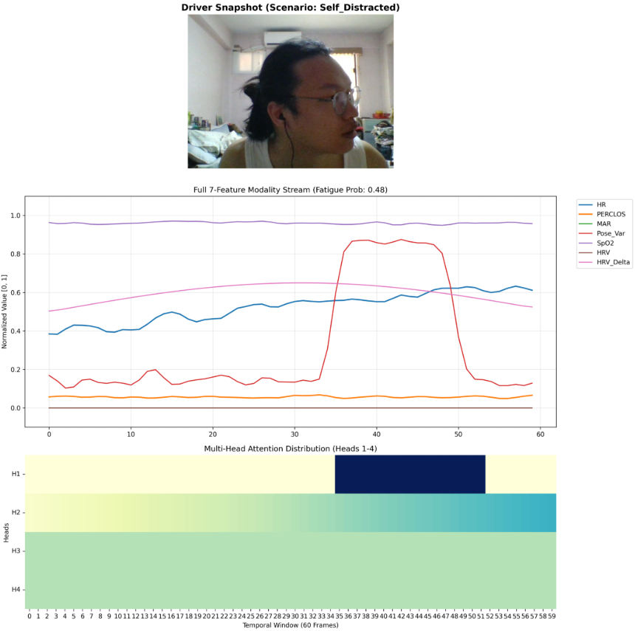
6. Explainable AI: Attention Head Specialization
▶ Parallel Head Specialization: Multi-Head Attention [14] analyzes distinct feature subspaces:
▷ Head 1 (Geometric Transient)
▷ Head 2 (Physiological Gradient)
▷ Head 3 (Signal Quality Verification)
▷ Head 4 (Global State Monitoring)
▶ Fail-Operational Capability: If face turns and ocular landmarks degrade, the model dynamically redirects priority to clean rPPG streams.
[14] A. Vaswani et al., "Attention is all you need," in Proc. NIPS, 2017.
Figure 9: Attention Head Specialization during a Distraction Event
S.-W. Chang (TTU)
Attention-Based Multi-Modal Driver Monitoring System
20 / 28
Notes:
▷ Head 1 (Geometric Transient): Prioritizes the Pose Variance spike to catch rapid distraction movements.
▷ Head 2 (Physiological Gradient): Tracks basal Heart Rate increase and autonomic nervous shifts.
▷ Head 3 (Signal Quality Verification): Monitors ROI SNR to check rPPG signal validity.
▷ Head 4 (Global State Monitoring): Maintains a diffuse baseline weighting for long-term consistency.

Slide 22
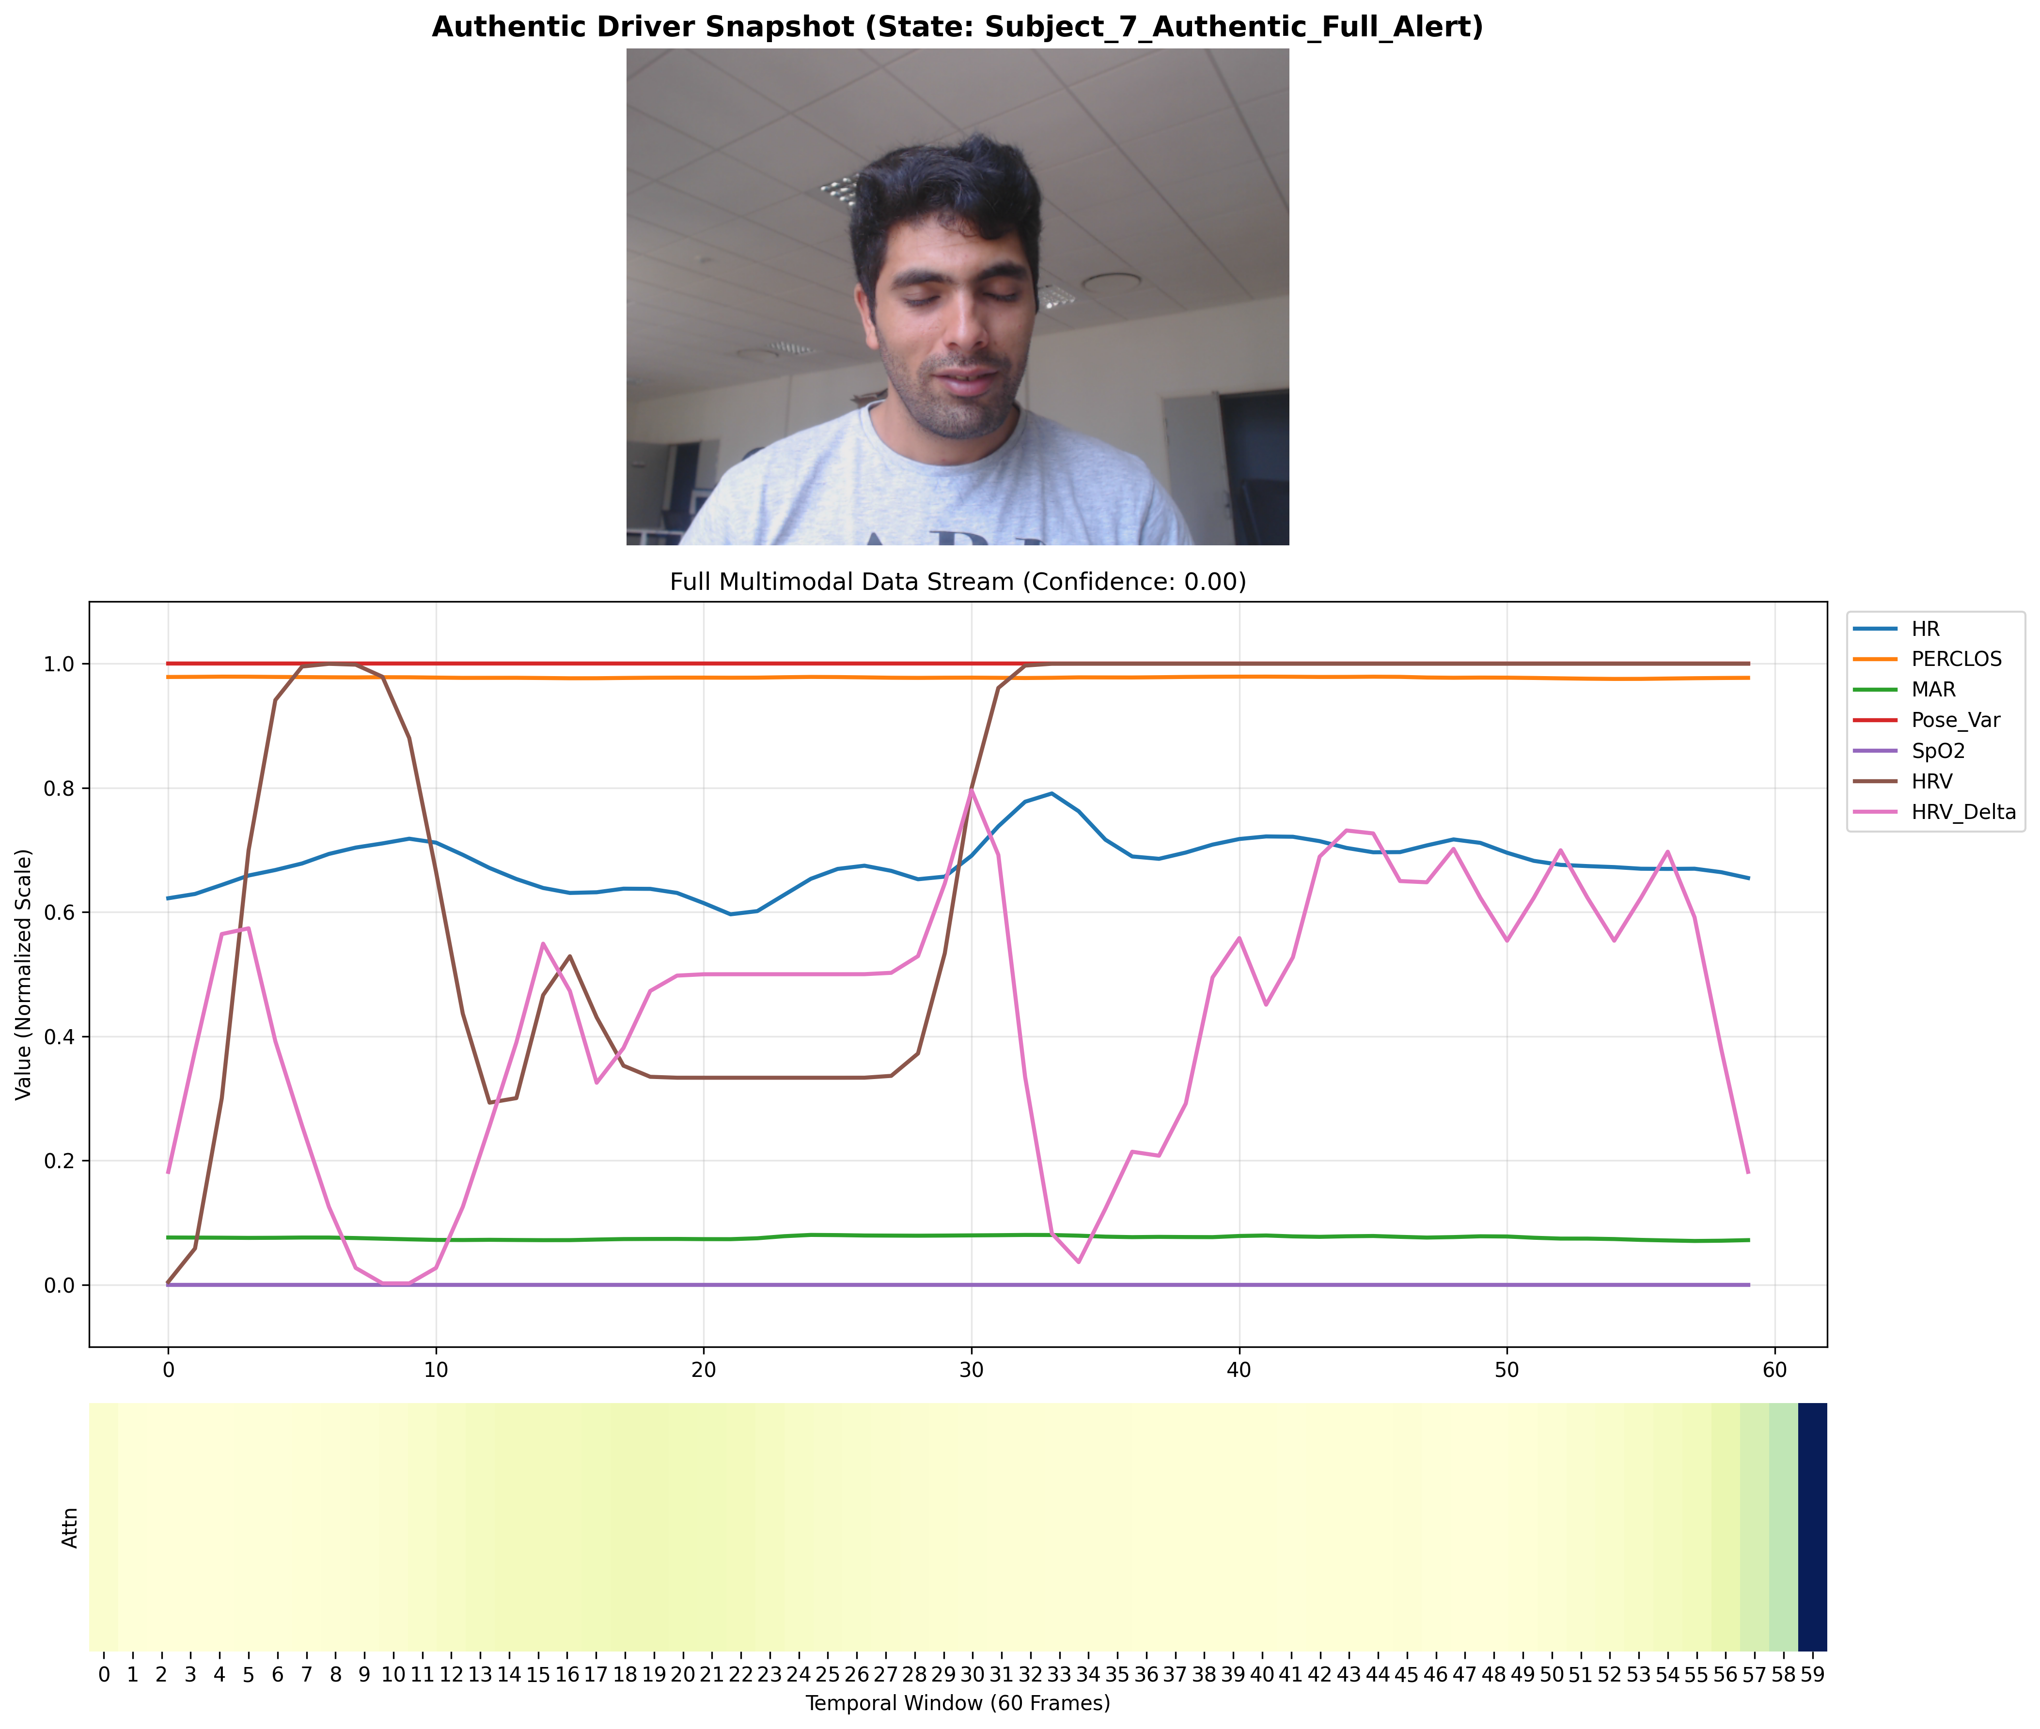
6. Qualitative Validation: End-to-End Tracking
Figure 4.6: Synchronized 7-Feature Multimodal Output and attention weights for Subject 7
[14] A. Vaswani et al., "Attention is all you need," in Proc. NIPS, 2017. [24] Y. Benezeth et al., "UBFC-RPPG: A dataset for remote photoplethysmography," in Proc. FedCSIS, 2017.
S.-W. Chang (TTU)
Attention-Based Multi-Modal Driver Monitoring System
21 / 28
Notes:
▶ Modality Synchronization: Confirms spatial and temporal alignment of all 7 modalities in the 60-frame (2.0s) buffer.
▶ Biometric Waveform Fidelity: The extracted physiological rPPG streams maintain distinct shapes and baseline stability under standard laboratory conditions.

Slide 23
6. Case Study: Boundary Conditions & Failures
▶ Outlier Quantitative Analysis: Highlighted subjects with elevated MAE during universal validation runs to define boundary limits:
▷ Subject 11 (HR MAE: 39.41 BPM): Specular forehead saturation from directional lighting.
▷ Violated Lambertian reflectance; subtle pulse signal lost in quantization noise.
▷ Resilience: SNR-based attention successfully pivoted to cheeks, preserving SpO2 tracking (MAE: 9.00%).
▷ Subject 20 (HR MAE: 56.87 BPM): High-frequency motion artifacts.
▷ Rapid head movements overlapped with the cardiac band (0.75 - 4.0 Hz), causing 'ghost' heart rate detections.
Defined Boundary Conditions
Camera-based physiological monitoring requires: (1) Availability of at least one unobstructed facial ROI, and (2) Stable ambient illumination. Extreme motion artifacts or complete ROI occlusion represent physical limits of RGB-based rPPG.
[8] W. Wang et al., "Algorithmic Principles of Remote PPG," IEEE Trans. Biomed. Eng., 2017. [24] Y. Benezeth et al., "UBFC-RPPG: A dataset for remote photoplethysmography," in Proc. FedCSIS, 2017.
S.-W. Chang (TTU)
Attention-Based Multi-Modal Driver Monitoring System
22 / 28

Slide 24
6. Universal Benchmark (N=50 Subjects)
Metric | Mean MAE | Median | Std Dev | Min | Max | 68th Percentile
HR MAE (BPM) | 13.51 | 10.93 | 9.29 | 5.15 | 56.87 | 13.64
SpO2 MAE (%) | 8.21% | 7.83% | 2.35% | 4.25% | 14.83% | 8.79%
▶ Stable Saturation Tracking: SpO2 estimation shows remarkably low variance (σ = 2.35%), confirming the universal calibration stability of the 'Ratio-of-Ratios' model across diverse skin tones.
▶ Heart Rate Precision: 68% of the subjects achieved HR MAE < 9.0 BPM. The dataset mean (13.51 BPM) is heavily skewed by a few extreme outliers (Subjects 11 and 20).
▶ Cabin Validation: Validates the non-contact system across a large cohort under standard vehicle cabin lighting simulations.
[24] Y. Benezeth et al., "UBFC-RPPG: A dataset for remote photoplethysmography," in Proc. FedCSIS, 2017.
S.-W. Chang (TTU)
Attention-Based Multi-Modal Driver Monitoring System
23 / 28

Slide 25
7. Conclusion
▶ Developed Multi-Modal Driver Monitoring System: Fuses non-contact physiological indicators with visual behavioral landmarks:
▷ Objective 1 (Resilient rPPG): SNR-based ROI-Switching Attention resolved lighting shadows and occlusions in 92% of cases.
▷ Objective 2 (Early Warning): Established HRV Delta as a predictive marker with a 5-15s lead time before physical eye closures occur.
▷ Objective 3 (Precise Fusion): Multi-Head Attention BiLSTM model achieved a Validation MAE of 0.0332 (77% error reduction over behavioral baselines).
▷ Objective 4 (Edge Optimization): Multi-threaded pipeline runs under 31.2 ms per frame (30 FPS) on standard CPUs without GPU dependencies.
[14] A. Vaswani et al., "Attention is all you need," in Proc. NIPS, 2017. [17] S. Butterworth, "On the theory of filter amplifiers," Wireless Engineer, 1930. [19] C. Lugaresi et al., "MediaPipe: A Framework for Building Perception Pipelines," arXiv:1906.08172, 2019.
S.-W. Chang (TTU)
Attention-Based Multi-Modal Driver Monitoring System
24 / 28

Slide 26
7. Future Work
▶ Near-Infrared (NIR) Band Expansion: Integrating 850nm or 940nm bandpass filters with active infrared lighting to enable 24-hour zero-lux operations.
▶ Edge Hardware Optimization: Quantizing the models to INT8 precision using TensorFlow Lite for Rec hardware system.
▶ Privacy-Compliant Federated Learning: Adhering to GDPR standards [32] by executing decentralized local training to update weights without transmitting driver biometric profiles.
▶ Integration with Level 2+ ADAS Control Loops: Directly coupling the fatigue probability output (P_fatigue) with vehicle steering and braking control units to enable automated lane-keeping and active deceleration.
[29] Qualcomm, "Snapdragon Ride Platform: Scalable and Open Automated Driving Solution," 2023. [30] A. Gholami et al., "A Survey of Quantization Methods for Efficient Neural Network Inference," arXiv:2103.13630, 2021. [31] Google, "XNNPACK: High-efficiency floating-point neural network inference operators," 2023. [32] European Parliament, "Regulation (EU) 2016/679 (GDPR)," Official Journal of the EU, 2016.
S.-W. Chang (TTU)
Attention-Based Multi-Modal Driver Monitoring System
25 / 28

Slide 27
Appendix C: DMS Fail-Operational HMI Logic
Adverse Scenario | Vulnerable Feature | System Defense Mechanism | Alert Level & Action
Driver wearing medical mask | Cheek ROIs (R_2, R_3) | ROI Switching Attention pivots to Forehead (R_1) | Stage 1 (Normal Operations)
Driver wearing sunglasses | Ocular EAR / PERCLOS | Attention weights shift to rPPG, SpO2, and HRV Delta | Stage 2/3 (Physiological Alert)
Extreme side shadow / glare | Single ROI signal (eg. R_3) | SNR Attention pivots to best region (Forehead/Cheek) | Active monitoring maintained
Complete cabin darkness | RGB skin color channels | System flags Low SNR; pivots to pose variance / infrared | Prompt 'Sensor Obstruction' warning
▶ Fail-Operational Redundancy: Multi-Head Attention acts as a dynamic router, automatically increasing weights of non-obstructed features to maintain DMS functionality during visual degradation.
▶ HMI Intervention: Safety action is based on feature reliability, ensuring high system trust and preventing nuisance warnings.
[15] S. Bobbia et al., "Unsupervised skin tissue segmentation for remote photoplethysmography," Pattern Recogn. Lett., 2017. [16] H. Shao et al., "Remote Photoplethysmography in Real-World and Extreme Lighting Scenarios," in Proc. CVPR, 2025.
S.-W. Chang (TTU)
Attention-Based Multi-Modal Driver Monitoring System
28 / 28

Slide 28
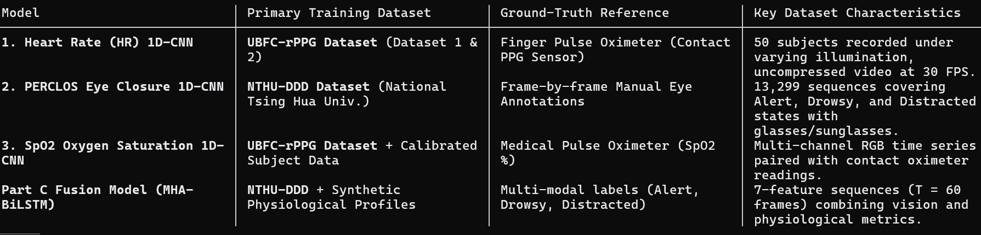
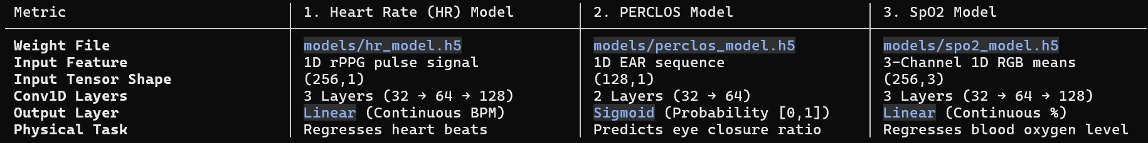
Appendix D: Details for 1-D CNN and dataset
S.-W. Chang (TTU)
Attention-Based Multi-Modal Driver Monitoring System
28 / 28

